Slide 1
Merge Sort
Hina Ali

Slide 2

Design Strategy Divide and conquer
Merge sort : belongs to divide and conquer algorithms: which follow following steps
Divide: Split the big problem into smaller ones that look just like the main one.
Merge sort divide an entire array Array[s:e] into two adjacent subarrays, each of half the size. How to split array into half i.e. find a m point, in case of merge sort we follow
m= └ (s+e) /2 ┘
Conquer: Solve these smaller problems one by one by using the same method. Sort each of the two subarrays Array[s:m], Array[m+1, e] recursively
using merge sort.
Combine: Put together the solutions of these smaller problems to solve the main one. by merging the two sorted subarrays Array[s:m], Array[m+1, e] back into producing the sorted array Array[s:e]
m =( s + e)
2
m = └4.5┘ = 4
start =s
end = e

Slide 3
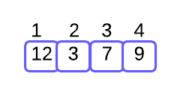
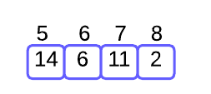
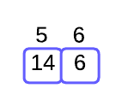
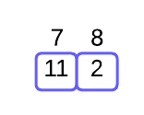
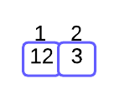
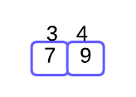








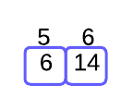
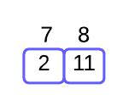
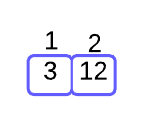

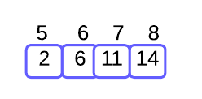
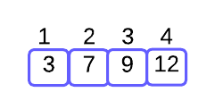
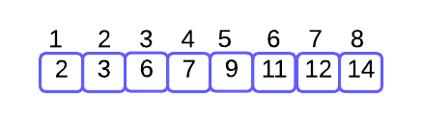
Example
mid = m
start =s
end = e
1
11
m
m
s
e
s
e
m
12
m
2
6
16
m
m
s
e
s
e
s
e
s
e
13
14
17
18
3
4
7
8
s, e
s, e
s, e
s, e
s, e
s, e
s, e
s, e
15
19
5
9
s, m
e
s, m
e
s, m
e
e
s, m
m
20
m
10
s
e
s
e
m
21
s
e

Slide 4
Example
mid = m
start =s
end = e
T(n)
1
11
m
m
s
e
s
e
T(n/2)
T(n/2)
m
12
m
2
6
16
m
m
s
e
s
e
s
e
s
e
T(n/4)
13
14
17
18
T(n/4)
3
4
7
8
s, e
s, e
s, e
s, e
s, e
s, e
s, e
s, e
T(n/8)
T(n/8)

Slide 5
Summery
Original
12
3
7
9
14
6
11
2
Divide in 2
12
3
7
9
14
6
11
2
Divide in 4
12
3
7
9
14
6
11
2
Divide in 8
12
3
7
9
14
6
11
2
Merge 2
3
12
7
9
6
14
2
11
Merge 4
3
7
9
12
2
6
11
14
Merge 8
2
3
6
7
9
11
12
14

Slide 6
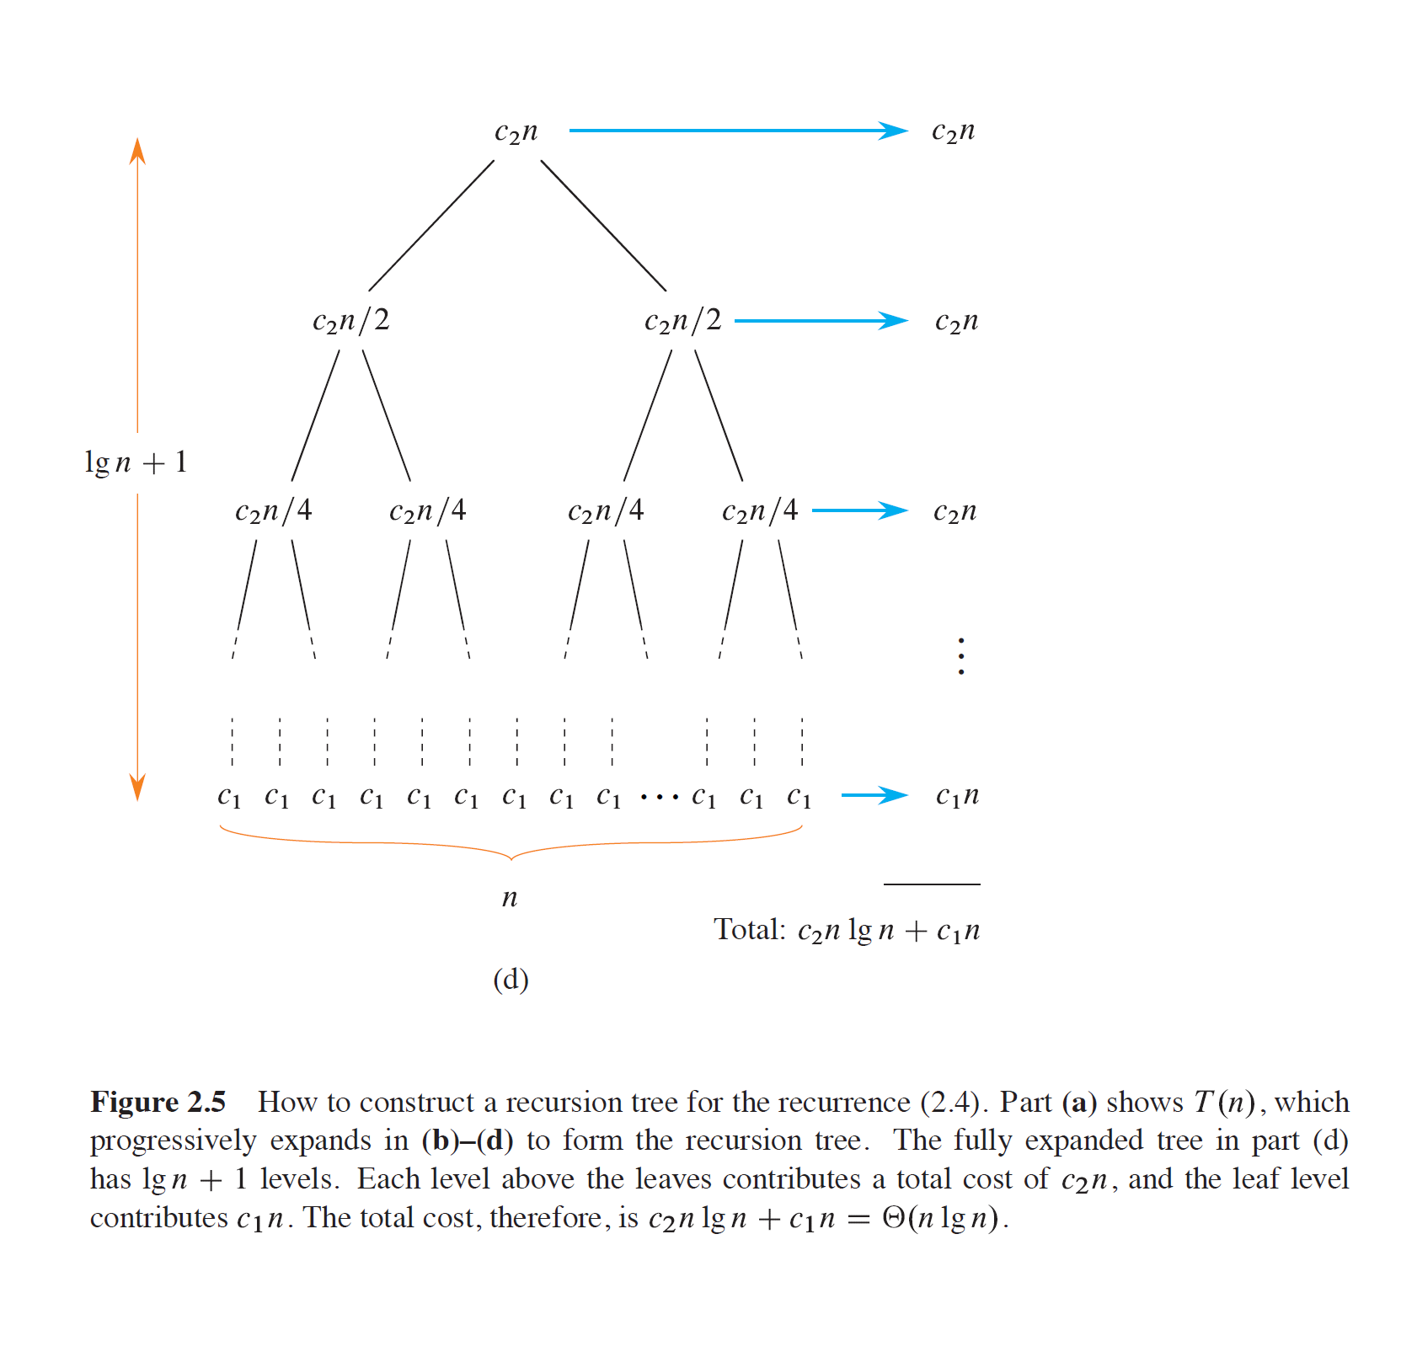
Complexity Analysis
Coreman

Slide 7
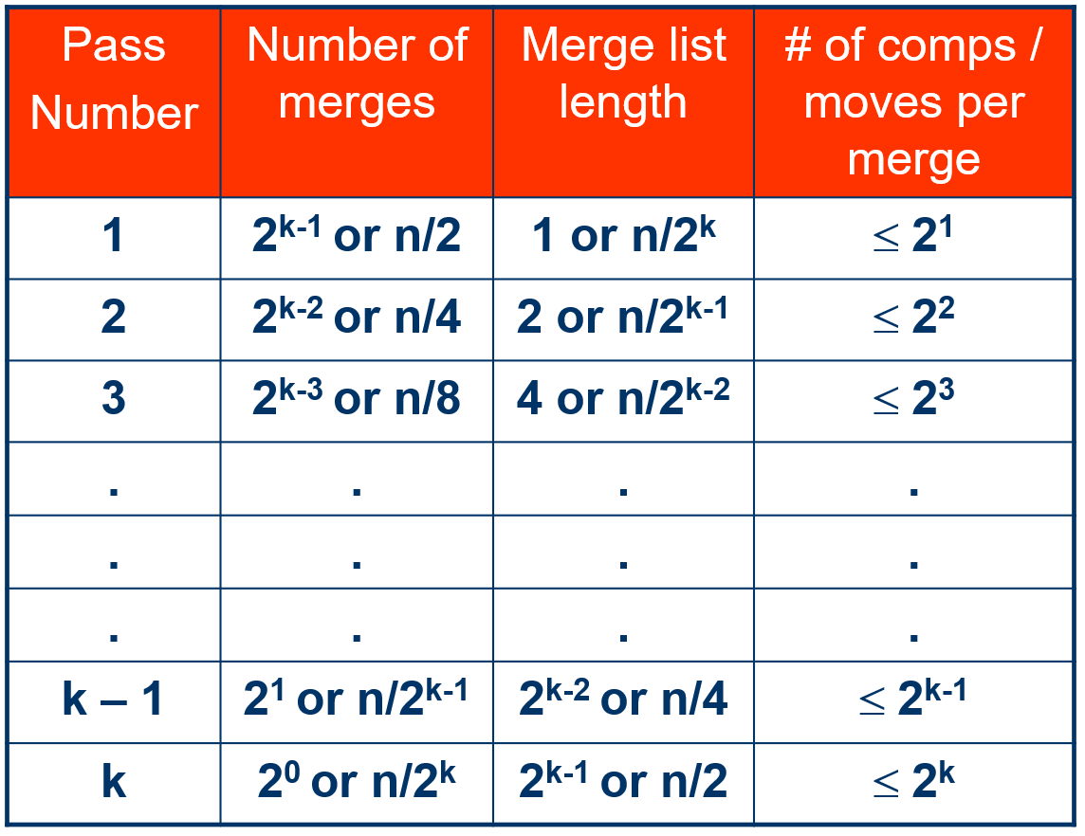

Slide 8
Pseudo code
MergeSort(A, p, r) {
if (p < r) { Θ(1)
mid = floor((p + r) / 2); Θ(1)
MergeSort(A, p, mid); T(n/2)
MergeSort(A, mid+1, r); T(n/2)
Merge(A, p, mid, r); Θ(n)
}
}

Slide 10
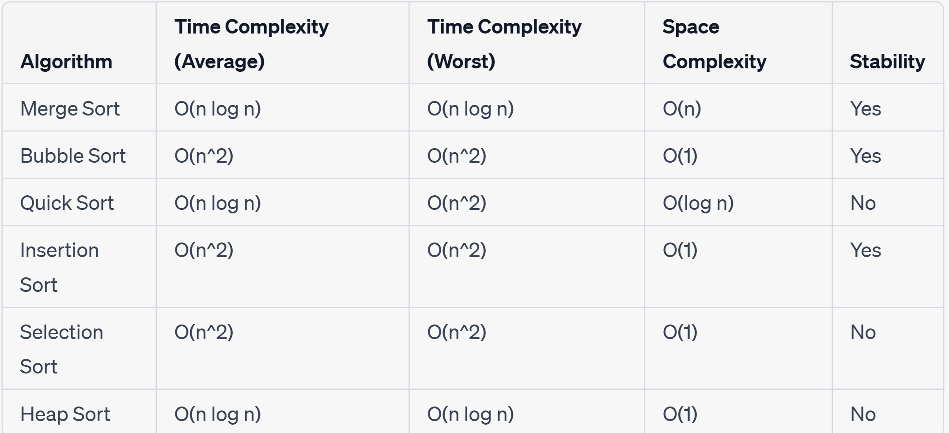
Comparative Analysis of Sorting Algorithms (adapted)

Slide 11
Questions
Suppose you have a sorted list of 128 names, and you’re sorting through it using binary search. What’s the maximum number of steps it would take?
Write out the code for the earlier sum function.
Write a recursive function to count the number of items in a list.
Write a recursive function to find the maximum number in a list.

